Slide 1
Conditional Statements Looping & Basic Features
P-000

Slide 2
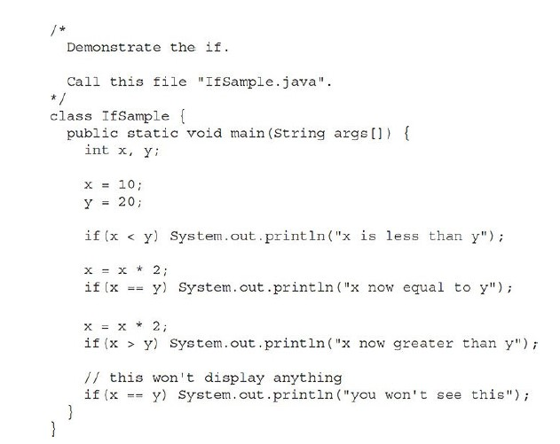
If
if(condition) statement;

Slide 3
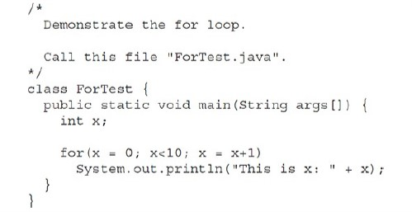
For
for(initialization; condition; iteration) statement;

Slide 4
Using Blocks of Code
Understanding the scopes of blocks of codes
For a class with its methods and attributes?
Ordering between two methods ?

Slide 5
Lexical Issues
Whitespace | Free form language (Same as C)
Identifiers | Same as C (But Camecase is a very popular style in Java)
Literals | Same as C
Comments | Same as C
Separators | In the next page

Slide 6
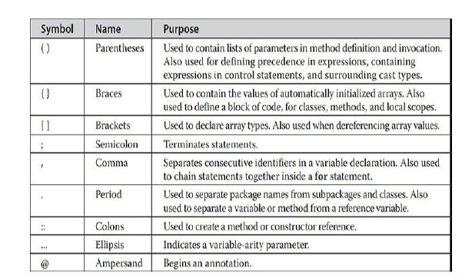
Separators
public class Example {
// Using varargs with ellipsis in a method
public static int sum(int... numbers) {
int result = 0;
for (int num : numbers) {
result += num;
}
return result;
}
public static void main(String[] args) {
// Calling the method with different numbers of arguments
System.out.println("Sum: " + sum(1, 2, 3)); // Sum: 6
System.out.println("Sum: " + sum(1, 2, 3, 4, 5)); // Sum: 15
System.out.println("Sum: " + sum(1, 2, 3, 4, 5, 6)); // Sum: 21
}
}
Use of ellipsis

Slide 7
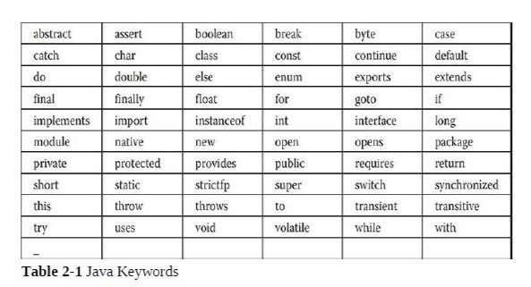
Java Keywords

Slide 8
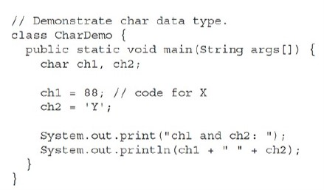
Primitive Types
Integer | Byte (8), short (16), int (32), and long (64)
Floating-point numbers | Float (32), double (64)
Characters | Char (8)
Boolean | boolean
Java is a strong typed language (Types are values are carefully maintained)

Slide 9
Some Interesting Usage and Points of Integer Literals
Usage of floating point literals is almost same
int x = 0b1010; | Binary
0x7ffffffffffffffL | Long given in Hexa
9223372036854775807L | Long given in Decimal
123_456_789 | Allowed number interpreted as 123456789
A primitive data type in Java.
Represents a 32-bit signed integer.
It cannot be null, as primitive types in Java always have a default value (e.g., 0 for int).
int
Integer
a class in the java.lang package.
A wrapper class that encapsulates the int primitive type.
Allows null values, as it is an object.
long v = 10L (L should always be specified)

Slide 10
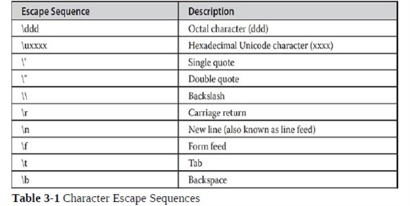
Usage of character literals
String Literal is just extension of character literals

Slide 11
Some known discussion
Variable definition: How variables are declared
Dynamic Initialization: Dynamically setting the values
Understanding scope and lifetime of variables: Which knows which
Usage of type conversion: type casting

